Slide 1
Week 03
HUMAN-COMPUTER
INTERACTION
Usman Institute of Technology
FALL 2021
CS411 Human Computer Interaction
Lecture 3 Human Side – Cognition Framework

Slide 2
In the Last Lecture
Usability and Quality
Interaction Design
Interaction Framework

Slide 3
In class exercise 1
Write a short note on the role of HCI in software development

Slide 4
In class exercise 2
How do you map usability goals to general development activities?

Slide 5
In class exercise 3
In practice, the makeup of a given design team depends on the kind of interactive product being built. Who do you think should be involved in developing:
A public kiosk providing information about the exhibits available in a science museum
An interactive educational website to accompany a TV series?

Slide 6
How will we proceed now ?
Foundation
Human Side
Computer Side
Interaction Design
Methods

Slide 7
In Today’s Lecture – Human Side
Factors in HCI
Interdisciplinary nature of HCI
Cognition
Cognitive Framework

Slide 8
Factors in HCI
Organizational Factors Training, job design, politics, roles Work organization |  | Environmental Factors Noise, heating, ventilation,lighting
Health and Safety Stress, headaches, Musculo-skeleton, disorders | Cognitive processes and capabilities The User Motivation, Enjoyment, Satisfaction, Personality Experience level |  | Comfort Level Seating Equipment layout
User Interface Input devices, output displays, dialogue structures, User of colour, icons, commands, graphics, natural language 3-D, user support materials, multimedia
Task Factors Easy, complex, novel, Task allocation, repetitive,Monitoring, skills, multi-media
Constraints Costs, timescales, budgets, Staff, equipment, building structure
System Functionality Hardware, software, application
Productivity Factors Increase output, increase quality, decrease costs, decrease errors,Decrease labour requirements, decrease production time, Increase creative and innovative ideas leading to new products

Slide 9
Cognitive
Psychology
Social
Organizational
Psychology
Linguistics
Anthropology
Ergonomics
&
Human
Factor
HCI
Philosophy
Design
Computer
Science
Engineering
Artificial
Intelligence

Slide 10
Going for a Drive
Driving a Car with a Keyboard
Steering with Arrow keys
Brake – Space bar
Acceleration – Enter
Indicators
Left – F1
Right – F2
Horn – F3
Headlights – F4
Windscreen Wipe – F5

Slide 11
Going for a Drive
Driving along on Highway
Suddenly a Cow comes in front
What do you do ?
What are your chances of survival

Slide 12
Cognitive Psychology
Psychology primarily concerned with human behavior and the mental processes that underlie it.
It is primarily concerned with information processing

Slide 13
Cognition
Process by which we became acquanted with things or in other words gain knowledge
Understanding
Remembering
Reasoning
Attending
Creating a new idea
How Humans and Computers interact with one another in terms of knowledge transmitted by them

Slide 14
Cognition
Also described in terms of specific process
Attention
Perception
Memory
Learning
Reading, speaking and listening
Problem solving, planning, reasoning, decision making

Slide 15
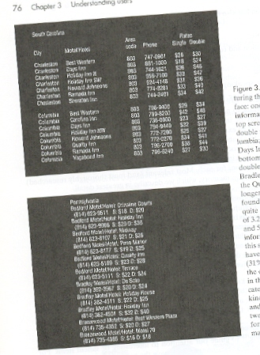

Slide 16
Cognition Modes
Experiential
We perceive, act and react to events around us effectively
Identify the cognitions shown in previous as experiential
Driving a car, reading
Reflective
Involves thinking , comparing and decision making

Slide 17
What Goes inside the head
Perceiving
Thinking
Remembering
Learning
Understanding others
Talking to others
Manipulation others
Planning a meal
Imaging a trip
Painting
Writing
Composing
Making decisions
Solving problems
daydreaming

Slide 18
Information Processing …
Lets look at how humans process information
Identify the following:

Slide 19
So what was it ?
Was it :
An elephant ?
A Tiger
An Apple
Roses
Roses Of course

Slide 20
Human Information Processing Model
Encoding
Comparison
Response
Selection
Response
Execution

Slide 21
How come we all Recognized them as Roses
Behind the scenes of Information processing in Humans:
Input Channels Sight, hearing, touch, smell, taste
Encoding information from environment in some kind of internal representation
Internal representation is compared with memorized representations (Comparison)
Concerned with deciding on a response to the encoded stimulus (Response Selection)
Organizing response and necessary action (Response Execution)

Slide 22
Extension to the Information Processing Model
Attention
Encoding
Comparison
Response
Selection
Response
Execution
Memory

Slide 23
Information Processing Analysis
Trace mental operations
Example Retrieving a friends phone number
Identifying friends Name
Retrieving meaning of words
Understanding the meaning of set of words given in the exercise
Retrieve number from memory
Generate plan and formulate the answer
Recite digits or write them down

Slide 24
Extended Model
How Information is perceived by the perceptual processors
How information is attended to
How information is processes and stored in Memory

Slide 25
Human Processor Model
Helps Conceptualize human behavior
Models of users: Model human Processor
Perceptual System
Motor System
Cognitive System

Slide 26
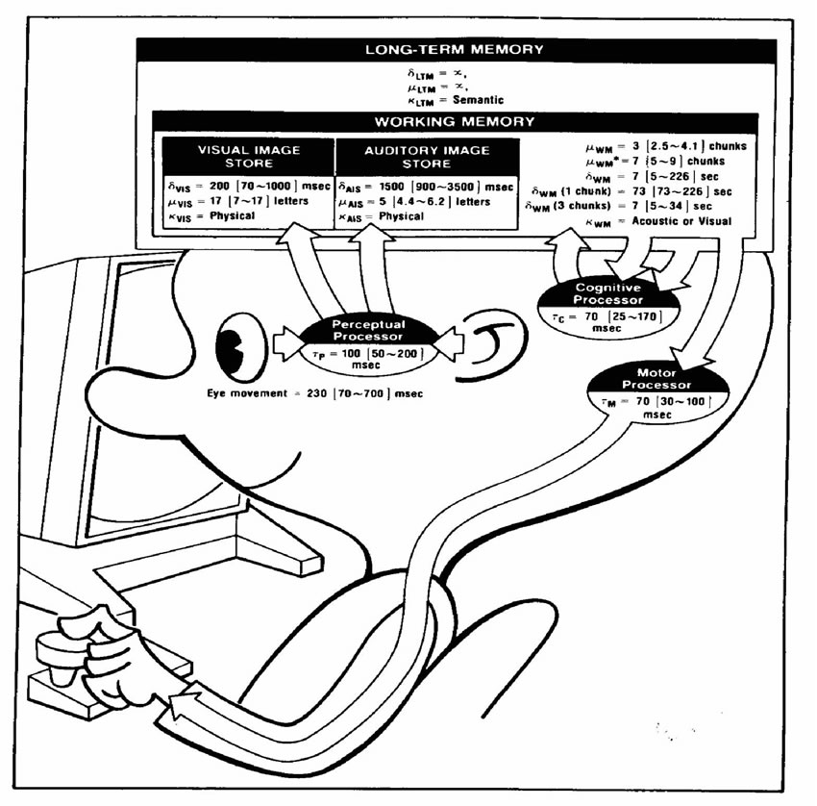

Slide 27
Models
Human Information Processing Models
Human Processor Models
These models assume that is based solely upon mental activities

Slide 28
More Models
Knowledge Representation Models
Mental Models
User Interaction Learning Models
Apply to HCI through
Conceptual Models
Interface Models

Slide 29
Other Approaches
Computational Approach
Computer metaphor as theoretical framework
What is involved when information is processed rather than how and when
Conceptualization of the goals planning and action in terms of task performance is done.
Emphasis on
What is important is processed

Slide 30
Other Approaches
Connectionist Approach
Neural network or parallel distributed approach
Rejects the computer metaphor
Adopts brain metaphor

Slide 31
Reports of Experts in HCI
Traditional approach to the study of cognition is to look at the pure intellect isolated from distraction and from artificial aids experiments are performed in a closed isolated rooms with a minimum distracting lights and sounds. No other people to assist with the task and no aids to memory or thought.

Slide 32
More Frameworks
External Cognition
Distributed Cognition

Slide 33
External Cognition
Externalizing to reduce memory load
Computational offloading
Annotating and Cognitive tracing

Slide 34
External Cognition - Externalizing
Knowledge is transformed into external representations
Example birthdays
Phone numbers
Addresses
Appointments
Talk about Ghalib tying knots to remember whatever verses he created at night

Slide 35
External Cognition – Computational Offload
Computational Offloading
Try the following
2 X 3
234 X 456
12 X 15
12387 X 9875

Slide 36
External Cognition – Annotating and Cognitive Tracing
Annotating and Cognitive tracing
Modify representation to reflect changes that are taking place
Annotating
Cognitive Tracing

Slide 37

Information Visualization

Slide 38
Distributed Cognitive framework
Describing cognition as it is distributed across individuals and settings (functional systems) in which it takes place.
To provide explanation to conceptualize cognitive activities
Analyze processing from the following aspect
Cognitive
Social
And Organization

Slide 39
Distributed Cognitive framework
Consider an example taking a plane to higher altitude
ATC gives clearance to pilot to fly to higher altitude (verbal)
Pilot changes altitude meter (mental and physical)
Captain observes pilot (visual)
Captain flies to higher altitude (mental and physical)

Slide 40
Summarize
In the Next Lecture
More detail about the cognitive processes

